Slide 1
Self-Care
College Prep
Mr. Gordon
jgordon@bisdtx.org

Slide 2
Upcoming Events
Tues. Sept. 21st Virtual 11th Grade Parent Meeting
Tues. Sept. 28th Spring Break 2023 Belize Travel Informational Meeting
hi

Slide 3
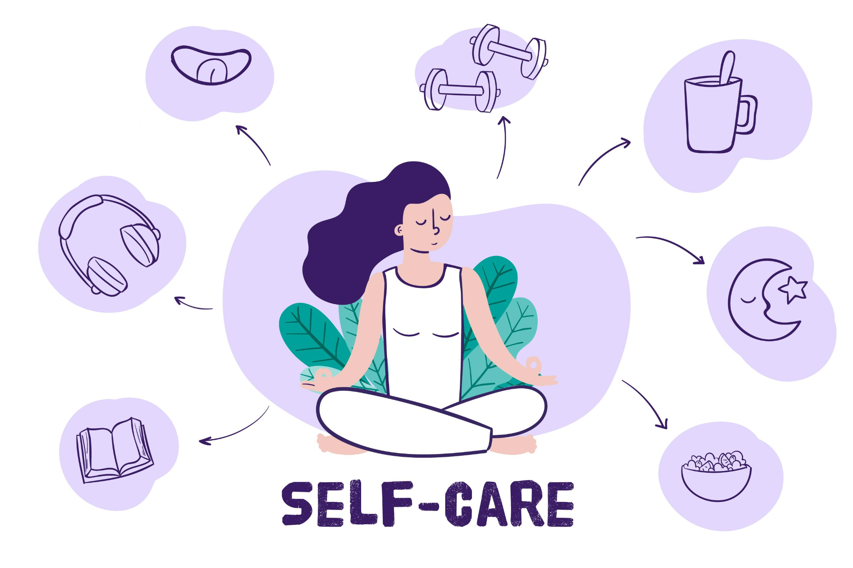
Self-Care
Sometimes it’s good to take a break and relax. Doing this prepares us for the day, and is good for our mental and emotional health.
Take three deep breaths. When you release the air, let it out slowly.
Stretch your neck, straighten your back.
Take a few sips of water.
hi

Slide 4
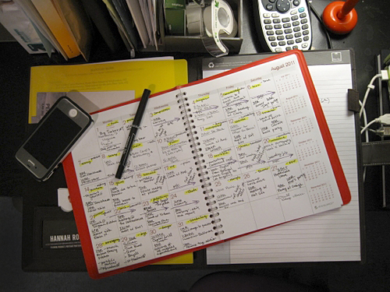
Assignments
Now take this time to look at your day planner. Ask yourself the following questions.
Do I have any missing or late assignments?
What big assignments/ projects are coming up in the next few weeks? Can I get ahead?
Plan and prioritize. Use the remaining time to work.
hi

Slide 5
Today’s College Prep Assignment
In the comments section of today’s College Prep,
answer the following question:
What do you do to relieve stress?
hi

